Slide 1
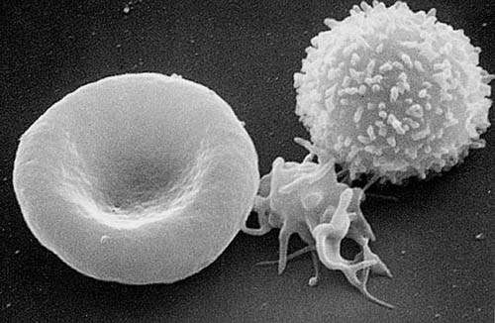
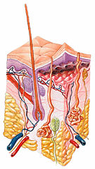
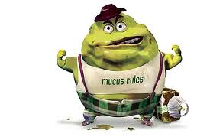
Infectious Diseases
Lesson 1.5

Slide 2
Lesson Objectives:
After finishing today’s lesson you will be able to:
define sterility and explain which parts of our bodies are non-sterile (external) and sterile (internal).
explain how commensal bacteria protect against infection.
describe the external barriers the body uses to prevent infection.
describe the internal defenses the body uses to prevent infection.

Slide 3
Do Now
What does sterile mean?
Use your worksheet to make a list of the sterile and non-sterile parts/organs of the human body.

Slide 4
What pattern do you see?
Normally sterile (closed to the environment) | Usually non-sterile (open to the environment)
Brain Spinal fluid Heart Liver Blood Muscles, And more! | Skin Mouth Stomach Intestines Upper respiratory tract, And more!

Slide 5
The epithelium separates the inside and outside of the body
Normally sterile (closed to the environment) | Usually non-sterile (open to the environment)
Brain Spinal fluid Heart Liver Blood Muscles, And more! | Skin Mouth Stomach Intestines Upper respiratory tract, And more!

Slide 6
Activity: Brainstorm the barriers that keep microbes outside the body
Skin
Tears
Stomach Acid
Mucus
Commensal Bacteria
Defensins
Intestinal Epithelium

Slide 7
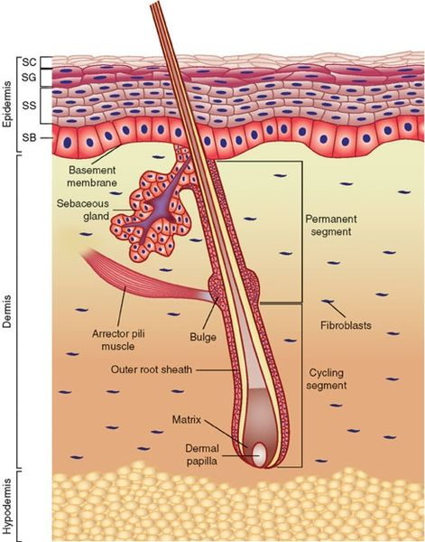
Skin – Epithelium
Physical barrier – very thick
Bottom is sterile; top is covered in commensal bacteria

Slide 8
Defensins chemicals that destroy pathogen membranes

Slide 9
Intestinal Epithelium physical barrier – only 1 layer thick so very vulnerable to damage

Slide 10
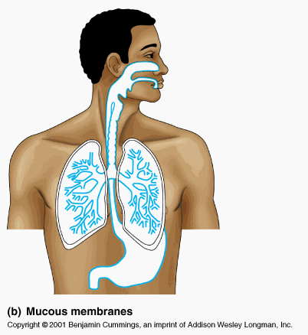
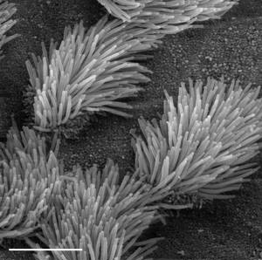
Mucus traps pathogens and contains enzymes that can destroy them; must be present on thin epithelial membranes (lungs and nose) that are vulnerable to damage

Slide 11
Tears washes pathogen away and contains enzymes that can destroy them

Slide 12
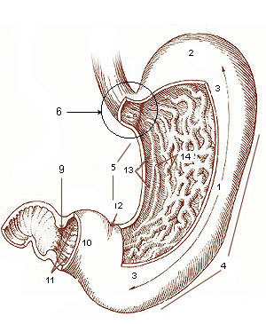
Stomach acid
Destroys pathogens with low pH

Slide 13
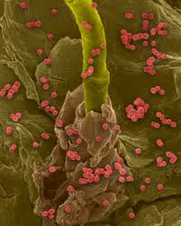
Commensal bacteria: we are an ecosystem!
Commensal bacteria on the skin outcompete pathogenic microbes.

Slide 14
What happens if an external barrier is breached?

Slide 15
Complement – the first line of defense – produced by the liver that kill bacteria and other invading cells by poking holes in their membranes and causing them to leak complement system
Notes:
Ask the students not to pay attention to the names if each molecule but to focus on the big picture.

Slide 16
Phagocytes – the second line of defense – ingest pathogens and destroys them

Slide 17
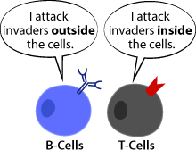
B cells/antibodies and T cells – the third line of defense.
Antibodies
B-Cells produce antibodies that neutralize pathogens and facilitate their phagocytosis
T-Cells: Helpers – activate B and T killer cells
Killers – destroy pathogen-infected host cells

Slide 18
Special barrier – commensal bacteria: competing with invaders while befriending the immune system

Slide 19
Wrap Up
Burning 21% of one’s skin is considered a major burn and a life-threatening health condition. It requires hospitalization and treatment in a special burn unit.
Why is a burn like this so serious?

Slide 20
Homework
Study for the unit 1 quiz!

